Slide 1
Fire Marshal Report for January 2024

Slide 2
National Fire Information Reporting
NFIRS for RRMFD and NSFD are good thru the end 2023.

Slide 3
Webinars / Trainings
OSCR360 Web Demonstration. Camera software for documenting crime scenes.
Documentation and First due training with all crews.
2024 Community Events
SAFMA Meeting
Lithium-Ion Batteries, Fire Investigation
Hydrant Flow Test and training

Slide 4
Burn Permits
-376 Camino Las Casitas

Slide 5
Plan Review and Inspection
C of O inspection 1152 Circulo Mercado.
Fire Wall inspection 1162 Avenida Gandara.
Remodel of 2 cold rooms at 785 E. Frontage Road.
383 Estrella vista Drive
Fire Wall inspection 381 Calle Faisan

Slide 6
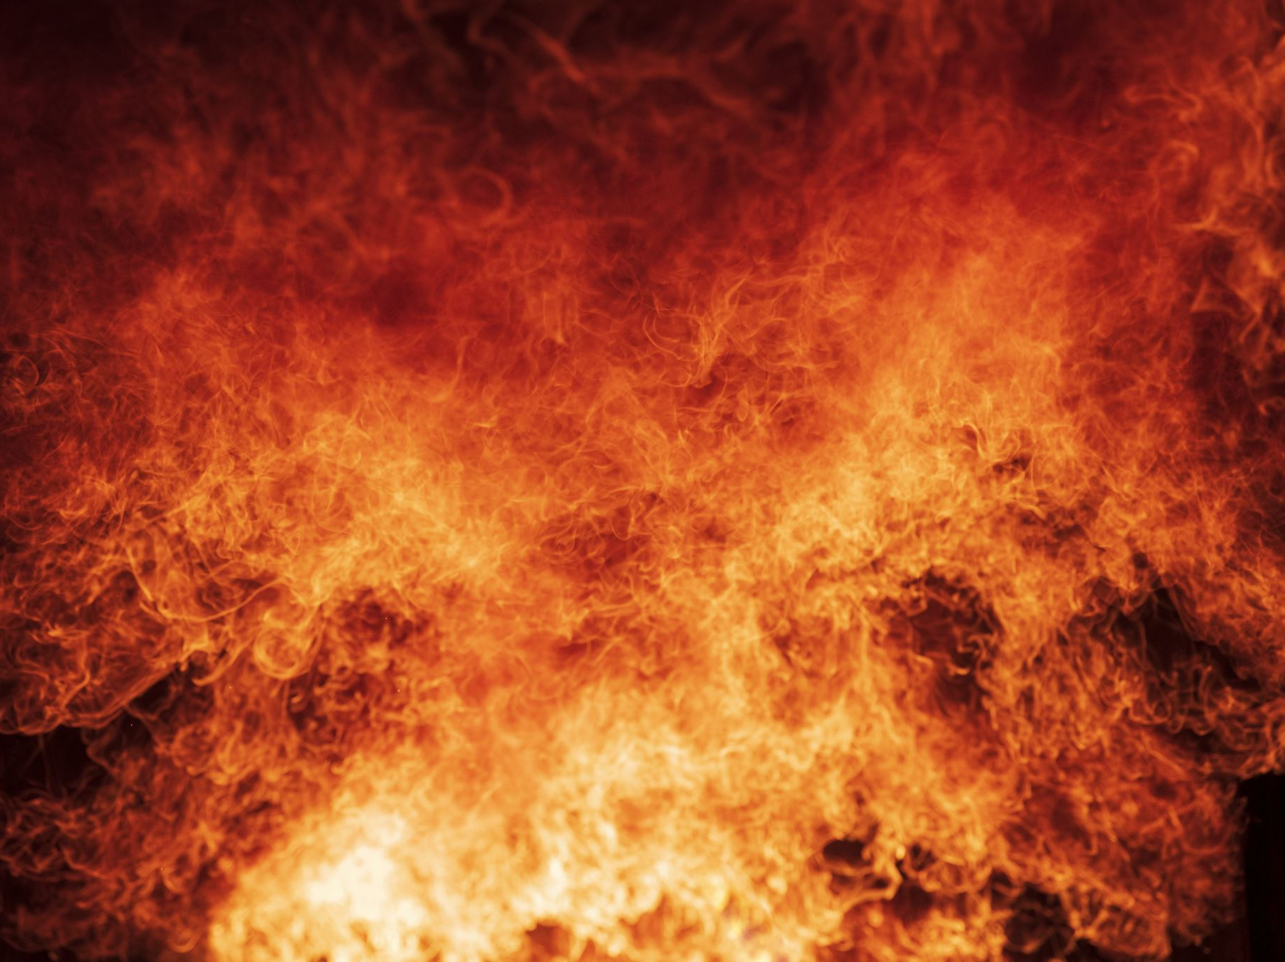
Fire Calls:
1225 Avenida Gandara (Vehicle Fire)

Slide 7
Community Events
Wade Carpenter Middle School career day
Rio Rico High School Career Day

Slide 8
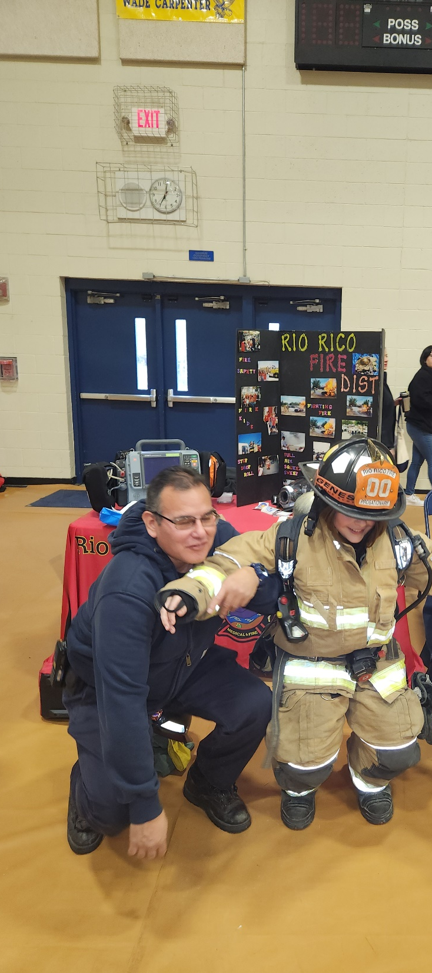
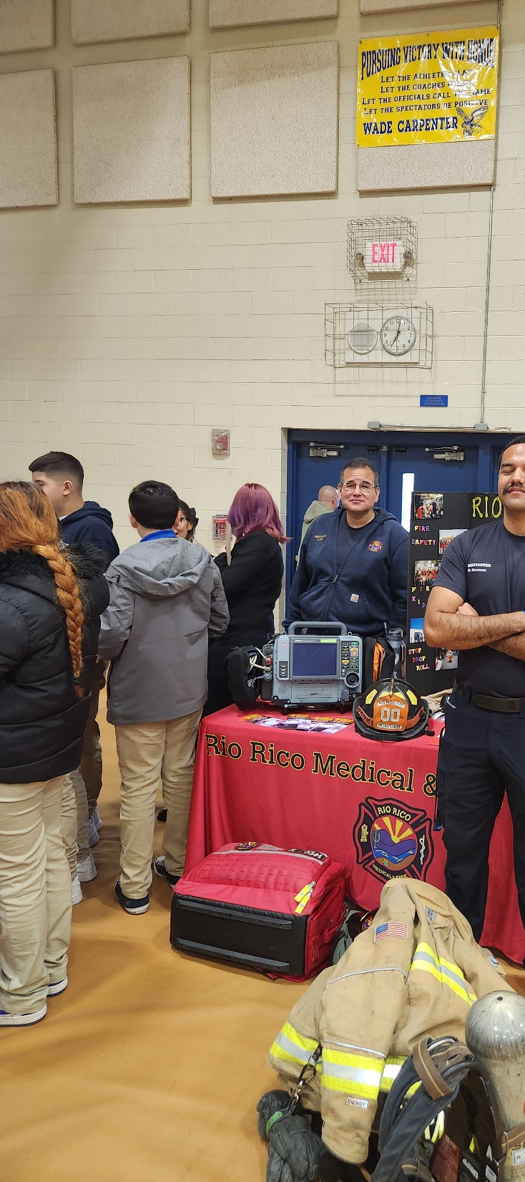
Wade Carpenter Middle School

Slide 9
End of report

